Slide 1
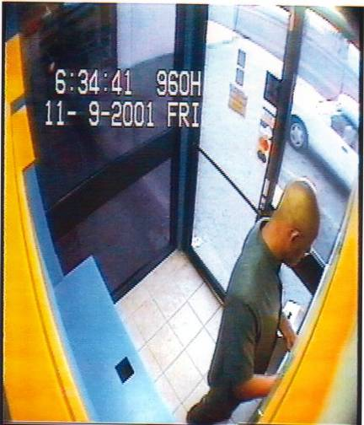
ATM THEFTS
In our first slide you see an individual who apparently is making a bank transaction at the ATM.
ordep44@hotmail.com

Slide 2
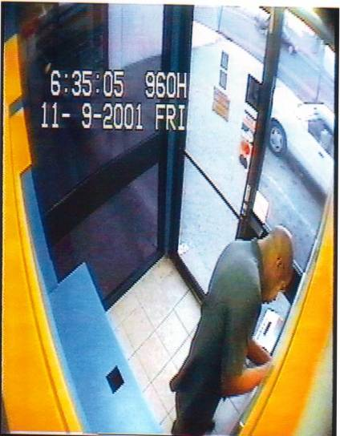
Placing the trap
What he really is doing is placing a trap in the ATM machine to “capture” the next user card.
ordep44@hotmail.com

Slide 3
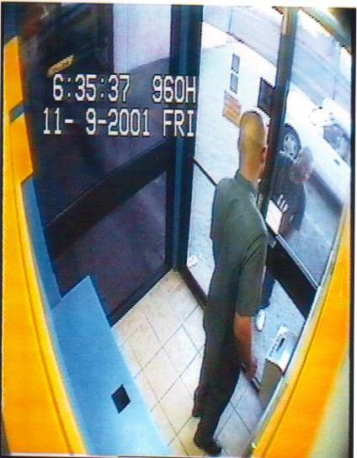
Lookout Warning
Altering the ATMs is a risky business, these individuals work in teams. The lookout warns of any possible eye witnesses / or of the next potential victim.
ordep44@hotmail.com

Slide 4
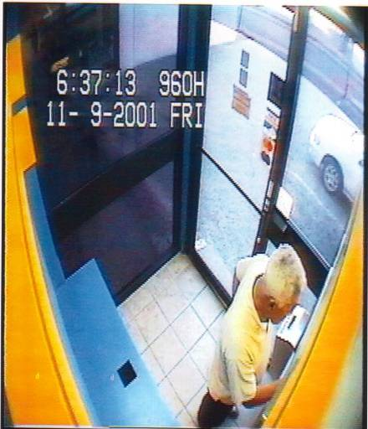
The Victim
Here we see the next client using the ATM, after the trap has been set. He inserts his card and begins his transaction.
ordep44@hotmail.com

Slide 5
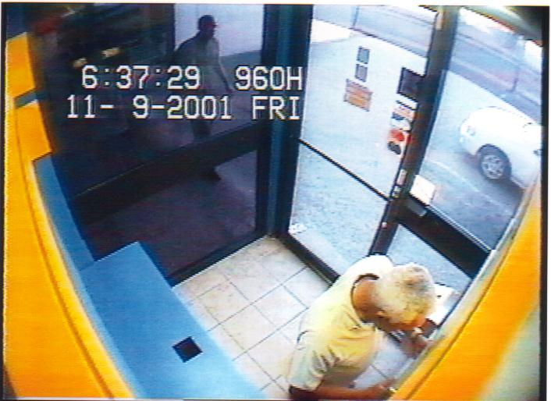
Springing the TRAP
The ATM card is confiscated, and the customer is confused, asking himself, Why has my card been confiscated? However, here we see the cavalry coming to help, (¿HELP?).
ordep44@hotmail.com

Slide 6
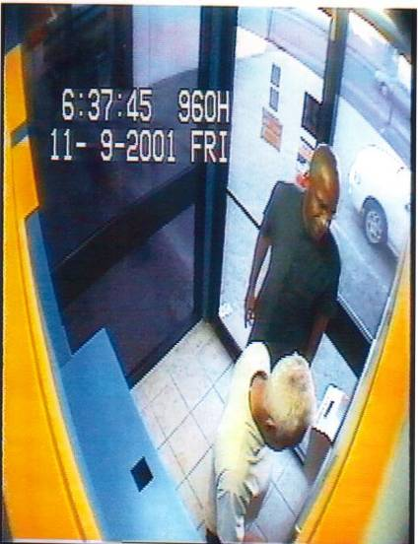
Honest,Samaritan Offering HELP
Here we see the thief pretending to help. What he is really doing is trying to gain the “chumps” PIN, now that he has captured his card.
ordep44@hotmail.com

Slide 7
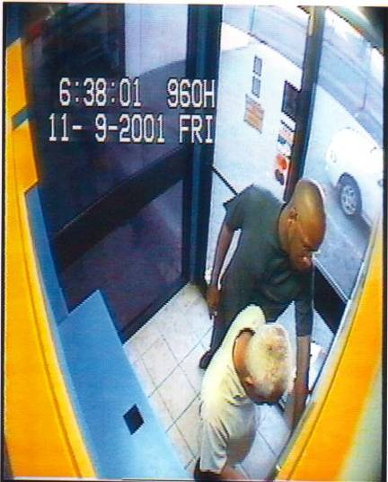
Gaining access to the PIN
The good Samaritan convinces the “chump” He can recover the card,if he presses his PIN at the same time the Samaritan press “cancel” and “enter”.
ordep44@hotmail.com

Slide 8
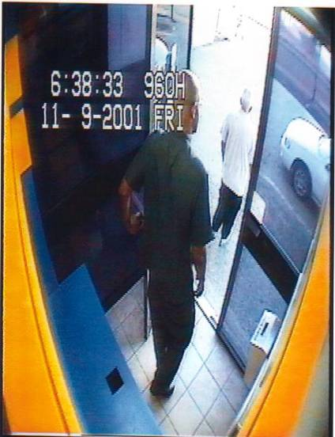
Situation Hopeless, “They Leave”
After several attempts the “chump”is convinced his card has been confiscated. The “chump” and the Samaritan leave the ATM.
ordep44@hotmail.com

Slide 9
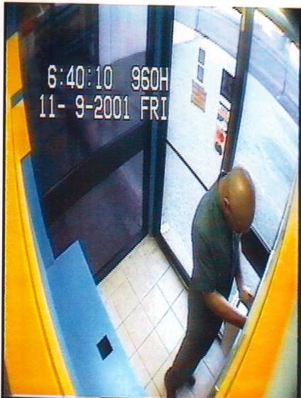
Recovering the CARD
Satisfied the area is clear, the thief
returns to recover the confiscated card from his trap. He not only has the card, he also has the PIN the “chump” provided unknowingly.
ordep44@hotmail.com

Slide 10
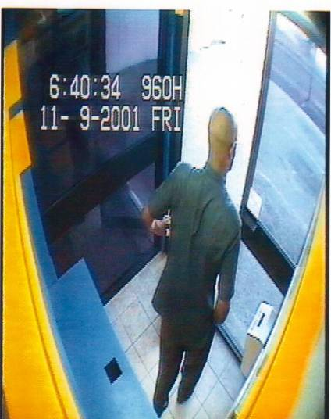
The Escape
In possession of the card and the PIN he leaves the ATM with $4000 from the “CHUMPS”account.
ordep44@hotmail.com

Slide 11
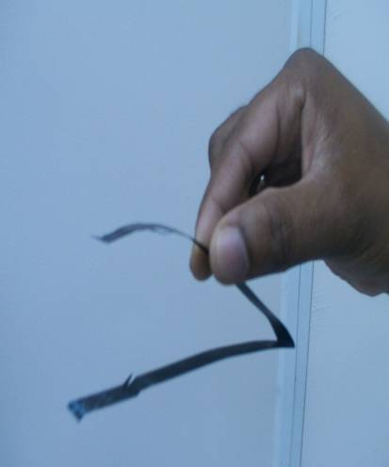
THE TRAP
The trap is made up of XRAY film, which is the preferred material by thieves; Simply because of the black color which is similar in appearance to the slot on the card reader.
ordep44@hotmail.com

Slide 12
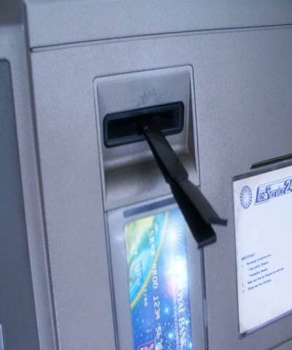
Placing the TRAP
The trap is then inserted into the ATM slot. Care is taken not to insert the entire film into the slot, the ends are folded and contain glue strips for better adhesion to the inner and outer surface of the slots.
ordep44@hotmail.com

Slide 13
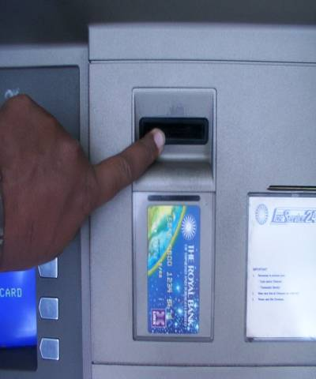
INVISIBLE
Once the ends are firmly glued and fixed to the slot, it is almost impossible to detect by unsuspecting clients.
ordep44@hotmail.com

Slide 14
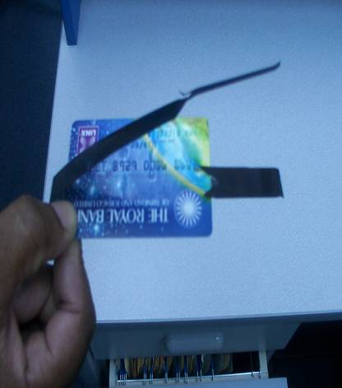
¿How is your card confiscated?
Slits are cut into both sides of the trap, This prevents your card being returned prior to completing your transaction.
ordep44@hotmail.com

Slide 15
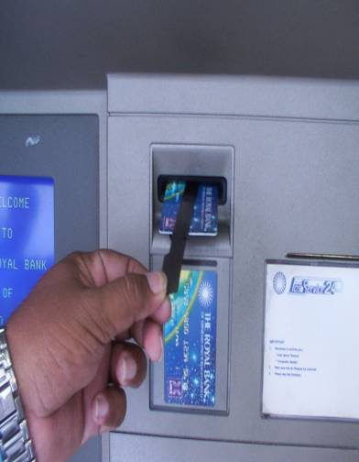
Retrieval of Confiscated card.
As soon as the “Chump” is gone, and they have your PIN , The thief can remove the glued trap, by grasping the folded tips, he simply pulls the trap out that has retained your card..
ordep44@hotmail.com

Slide 16
RECOMENDATIONS.
1.-Once your card has been confiscated, observe the ATM slot and the card reader for any signs of tampering. Should you see the film tips glued to the slot, unglue, pull the trap out and recover your card.
2.- Report IMMEDIATELY to the BanK.
ordep44@hotmail.com

Slide 17
Send this message to friends and family immediately.

